Slide 1
Railway Reservation System

Slide 2
PRESENTED BY
CHIRAG DUA

Slide 3
Introduction of Project
The "Railway Reservation System" has been developed to override the problems prevailing in the practicing manual system. This software is supported to eliminate and in some cases reduce the hardships faced by this existing system. Moreover this system is designed for the particular need of the company to carry out operations in a smooth and effective manner.
The application is reduced as much as possible to avoid errors while entering the data. It also provides error message while entering invalid data. No formal knowledge is needed for the user to use this system. Thus by this all it proves it is user-friendly. Railway Reservation System , as described above, can lead to error free, secure, reliable and fast management system. It can assist the user to concentrate on their other activities rather to concentrate on the record keeping. Thus it will help organization in better utilization of resources.

Slide 4
Abstract of Project
The purpose of Railway Reservation System is to automate the existing manual system by the help of computerized equipments and full-fledged computer software, fulfilling their requirements, so that their valuable data/information can be stored for a longer period with easy accessing and manipulation of the same. The required software and hardware are easily available and easy to work with.
Railway Reservation System, as described above, can lead to error free, secure, reliable and fast management system. It can assist the user to concentrate on their other activities rather to concentrate on the record keeping. Thus it will help organization in better utilization of resources. The organization can maintain computerized records without redundant entries. That means that one need not be distracted by information that is not relevant, while being able to reach the information.

Slide 5
Objective of Project
Provides the searching facilities based on various factors. Such as Train, City, Customer, Booking
Railway Reservation System also manage the Payment details online for Customer details, Booking details, Train.
It tracks all the information of Route, Payment, Customer etc
Manage the information of Route
Shows the information and description of the Train, City
To increase efficiency of managing the Train, Route
It deals with monitoring the information and transactions of Customer.
Manage the information of Train

Slide 6
FUNCTIONS OF USER
Train Enquiry
Book Ticket
Payment
Check PNR Status
Register
Login and Logout
Contact for queries

Slide 7
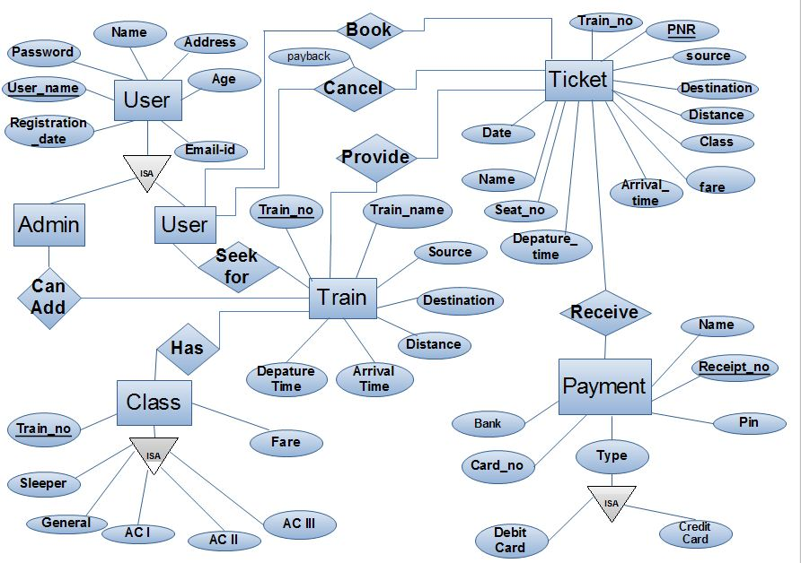
ER DIAGRAM

Slide 8
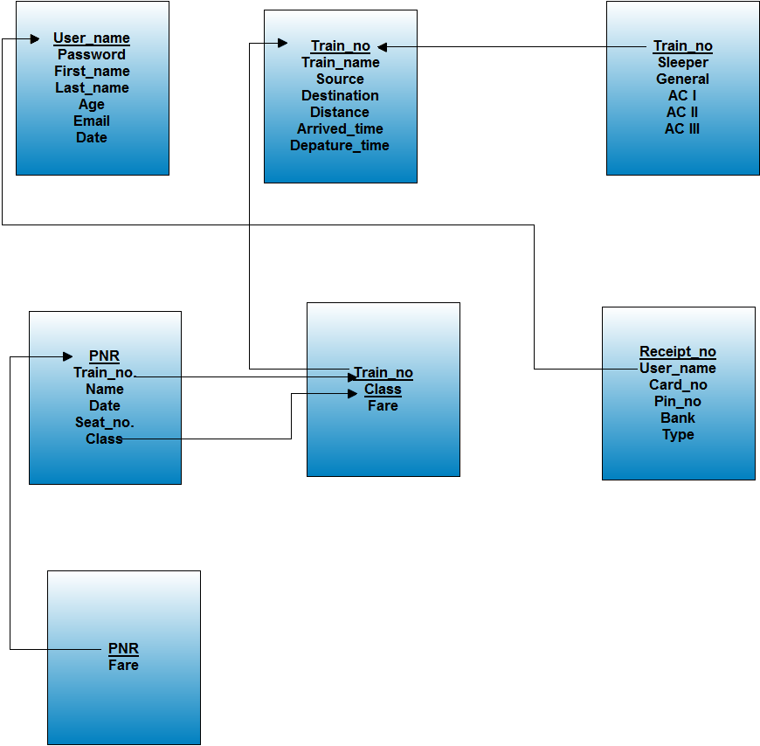

Slide 9
Modules of the Project
Train Management Module: Used for managing the Train details.
Booking Module : Used for managing the details of Booking
Payment Module : Used for managing the details of Payment
Route Management Module: Used for managing the information and details of the Route.
City Module : Used for managing the City details
Customer Module : Used for managing the Customer information
Login Module: Used for managing the login details
Users Module : Used for managing the users of the system

Slide 10
Report of the Project
It generates the report on Train, Route, Payment
Provide filter reports on City, Customer, Booking
You can easily export PDF for the Train,Payment, Customer
Application also provides excel export for Route, City, Booking
You can also export the report into csv format for Train, Route, Booking

Slide 11
Data Validation of the project
All the fields such as Train, City, Booking are validated and does not take invalid values
Each form for Train, Route, Payment can not accept blank value fields
Avoiding errors in data
Controlling amount of input
Integration of all the modules/forms in the system.
Preparation of the test cases.
Preparation of the possible test data with all the validation checks.
Actual testing done manually.
Recording of all the reproduced errors.

Slide 12
Software Requirements Specification
Name of component | Specification
Operating System | Windows 98, Windows XP, Windows7, Linux
Language | PHP
Database | MySQL Server
Browser | Any of Mozilla, Opera, Chrome etc
Web Server | Apache2
Software Development Kit | WAMP or XAMP
Scripting Language Enable | JavaScript
Database Driver | MySQLi

Slide 13
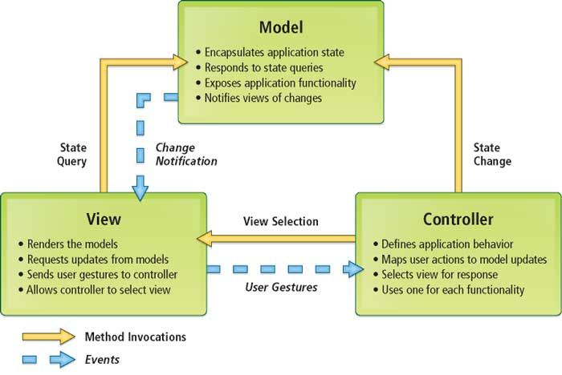
Implementation Methodology

Slide 14
Conclusion of the Project
Our project is only a humble venture to satisfy the needs to manage their project work. Several user friendly coding have also adopted. This package shall prove to be a powerful package in satisfying all the requirements. The objective of software planning is to provide a frame work that enables the manger to make reasonable estimates made within a limited time frame at the beginning of the software project and should be updated regularly as the project progresses.
A description of the background and context of the project and its relation to work already done in the area.
Made statement of the aims and objectives of the project.
The description of Purpose, Scope, and applicability.
We define the problem on which we are working in the project.
We describe the requirement Specifications of the system and the actions that can be done on these things.

Slide 15
Future Scope of the Project
In a nutshell, it can be summarized that the future scope of the project circles around maintaining information regarding:
We can add printer in future.
We can give more advance software for Railway Reservation System including more facilities
We will host the platform on online servers to make it accessible worldwide
Integrate multiple load balancers to distribute the loads of the system
Create the master and slave database structure to reduce the overload of the database queries
Implement the backup mechanism for taking backup of codebase and database on regular basis on different servers

Slide 16
Limitation of Project
Although I have put my best efforts to make the software flexible, easy to operate but limitations cannot be ruled out even by me. Though the software presents a broad range of options to its users some intricate options could not be covered into it; partly because of logistic and partly due to lack of sophistication. Paucity of time was also major constraint, thus it was not possible to make the software foolproof and dynamic. Lack of time also compelled me to ignore some part such as storing old result of the candidate etc.
Considerable efforts have made the software easy to operate even for the people not related to the field of computers but it is acknowledged that a layman may find it a bit problematic at the first instance. The user is provided help at each step for his convenience in working with the software.

Slide 17
References and Bibliography
Google for problem solving
http://www.PHPworld.com/PHPworld/jw-01-1998/jw-01-Credentialreview.html
Database Programming with JDBC and PHP by O'Reilly
Head First PHP 2nd Edition
http://www.jdbc-tutorial.com/
PHP and Software Design Concepts by Apress
https://www.tutorialspoint.com/PHP/
http://www.PHPtpoint.com/PHP-tutorial
https://docs.oracle.com/PHPse/tutorial/
http://www.wampserver.com/en/
http://www.PHP.net/
http://www.tutorialspoint.com/mysql/
httpd.apache.org/docs/2.0/misc/tutorials.html

Slide 18
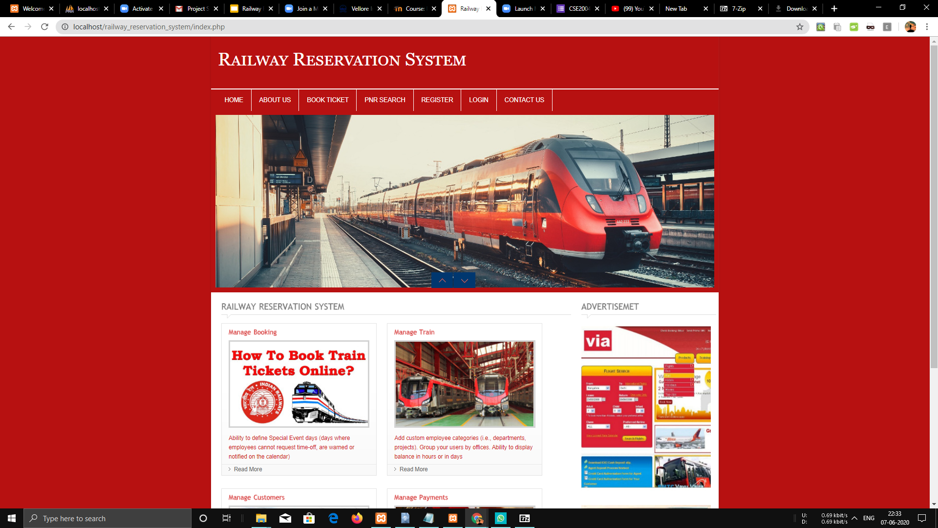
SNAPSHOTS

Slide 19
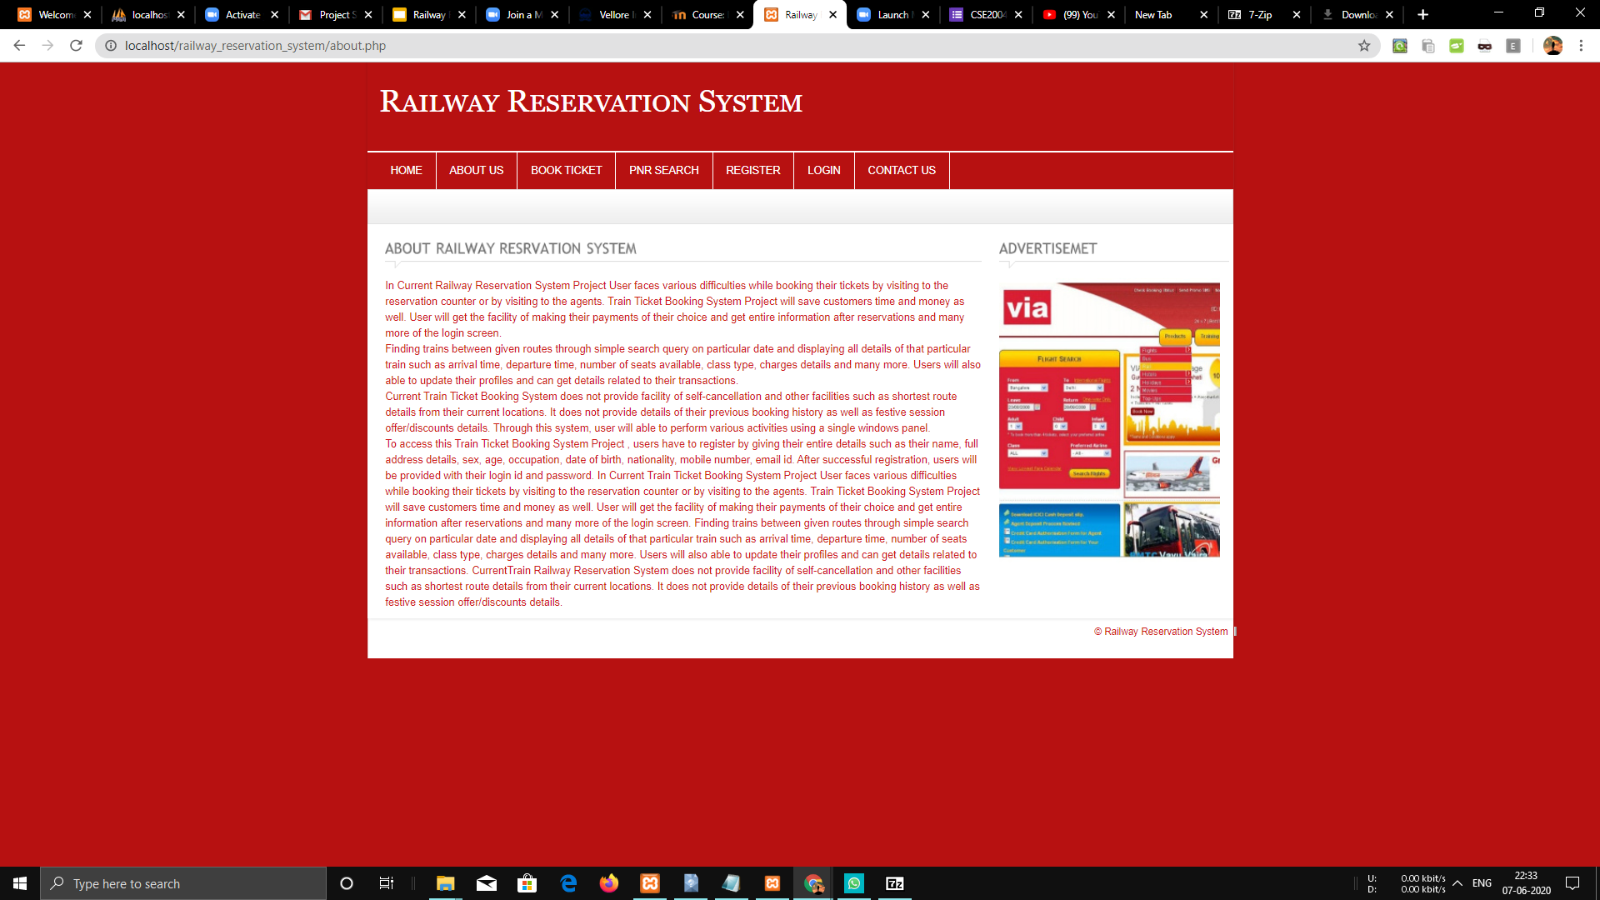

Slide 20
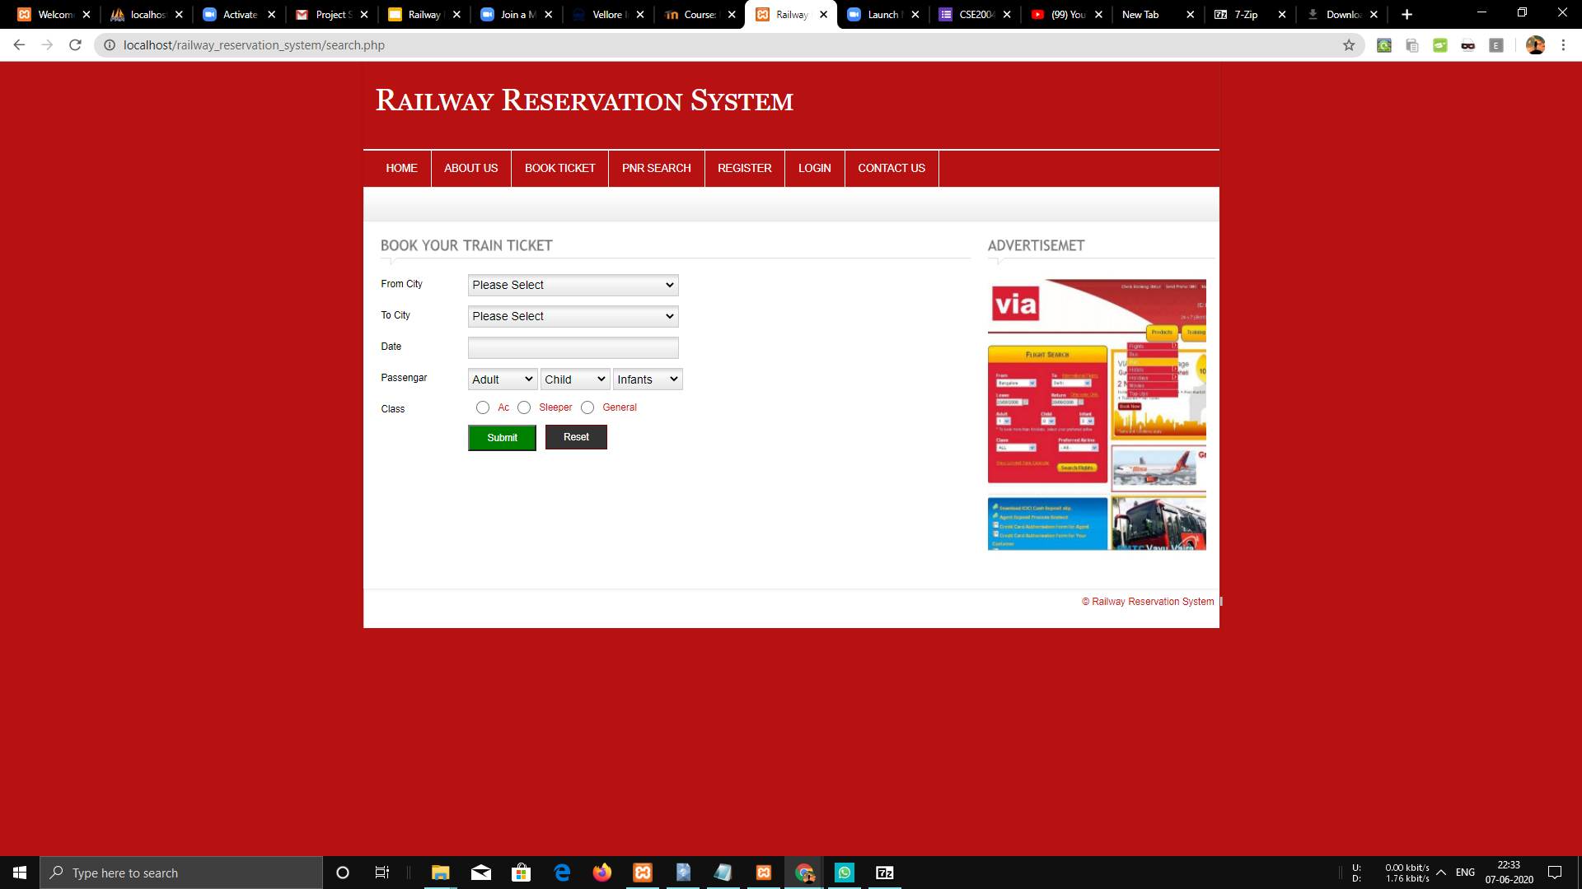

Slide 21
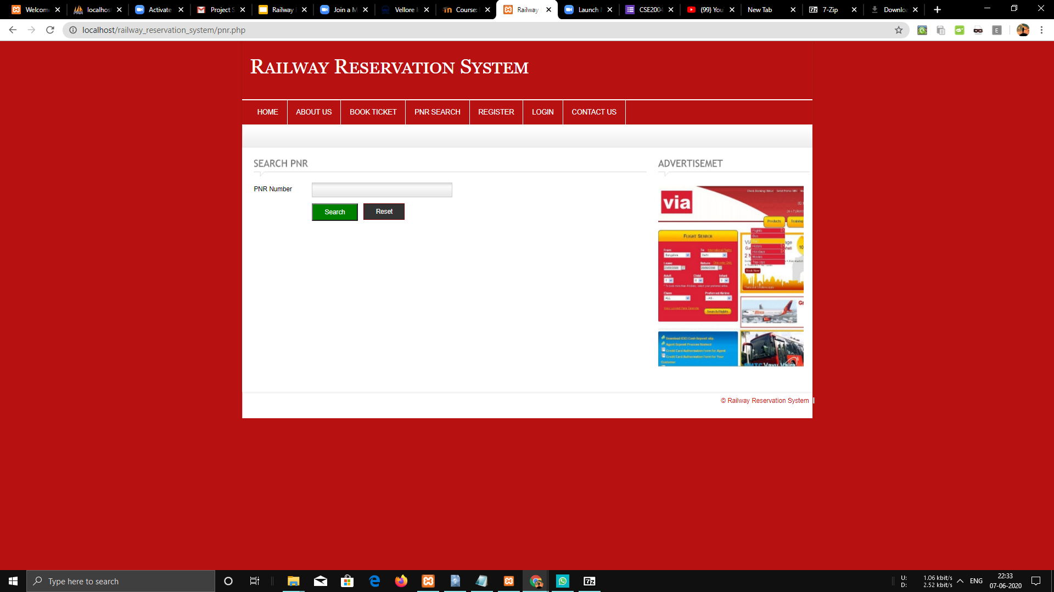

Slide 22
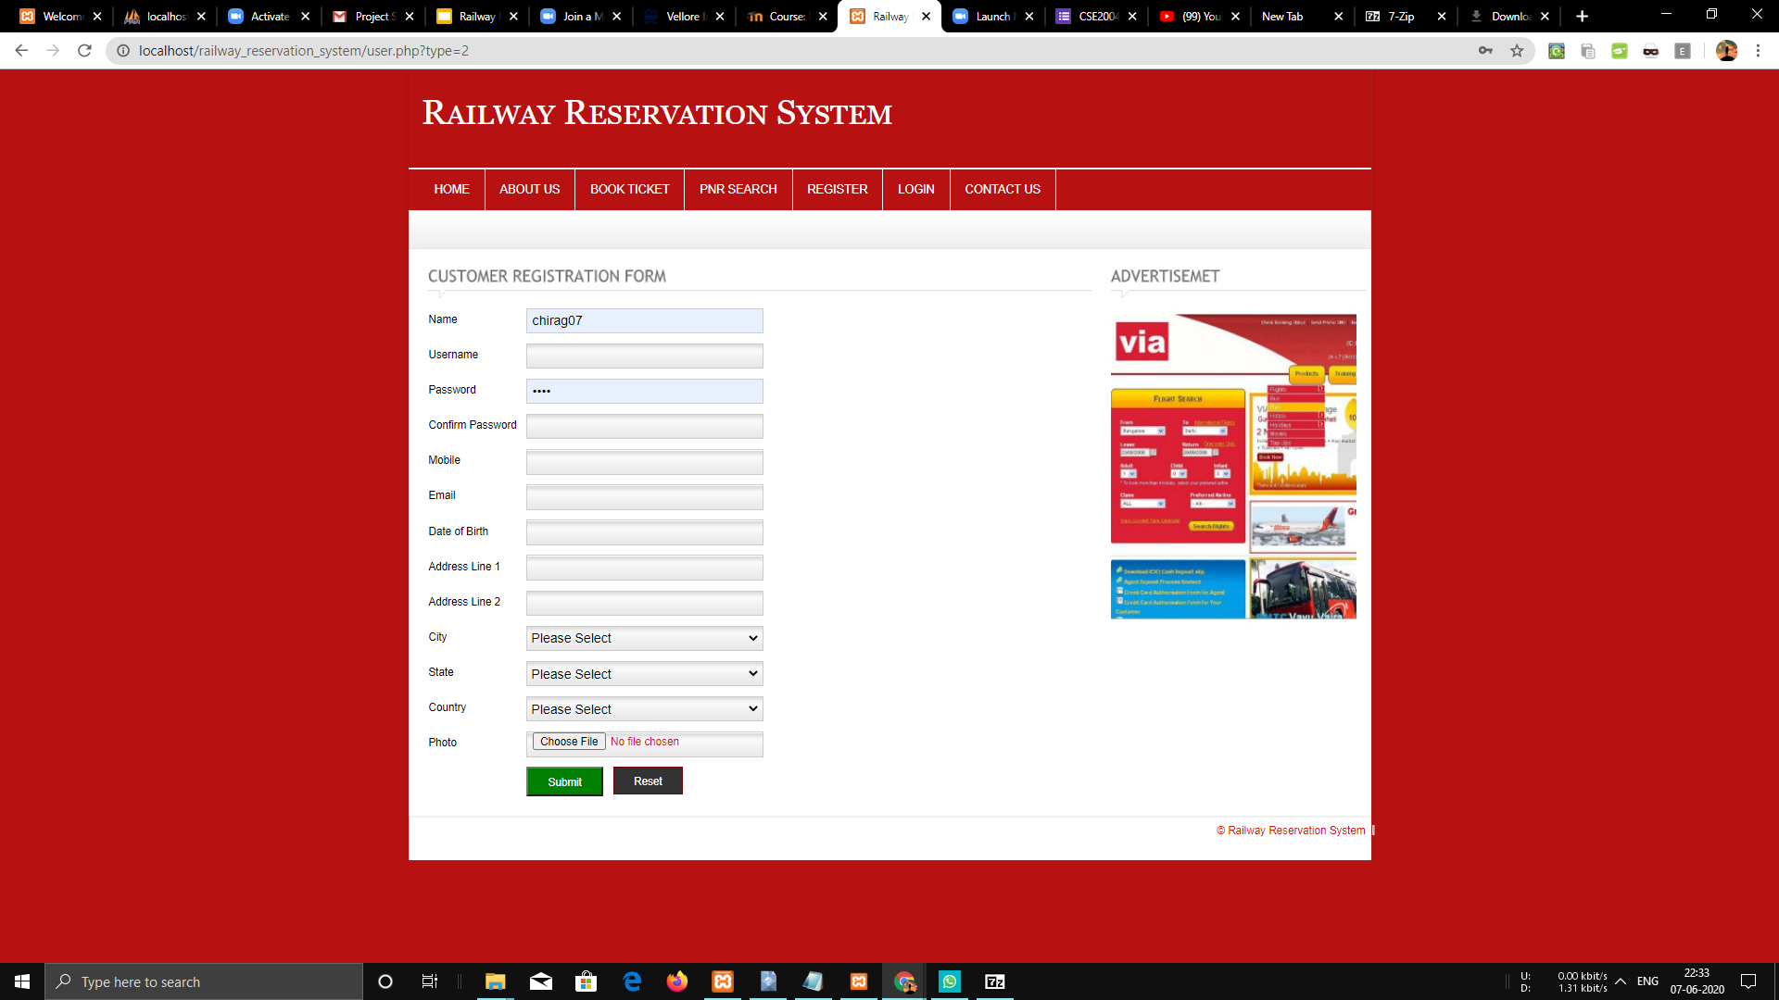

Slide 23
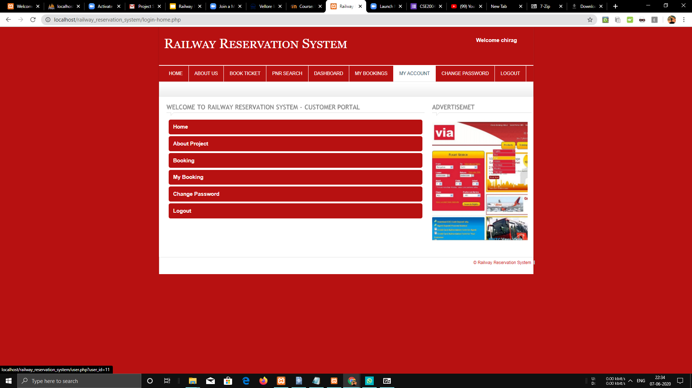

Slide 24
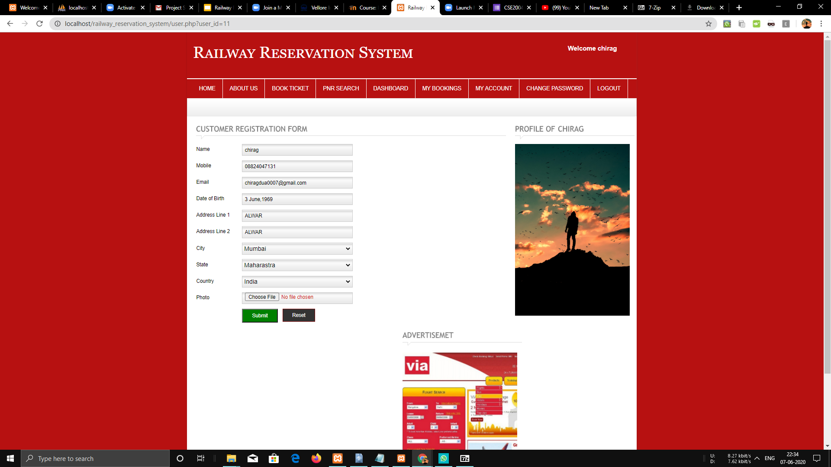

Slide 25
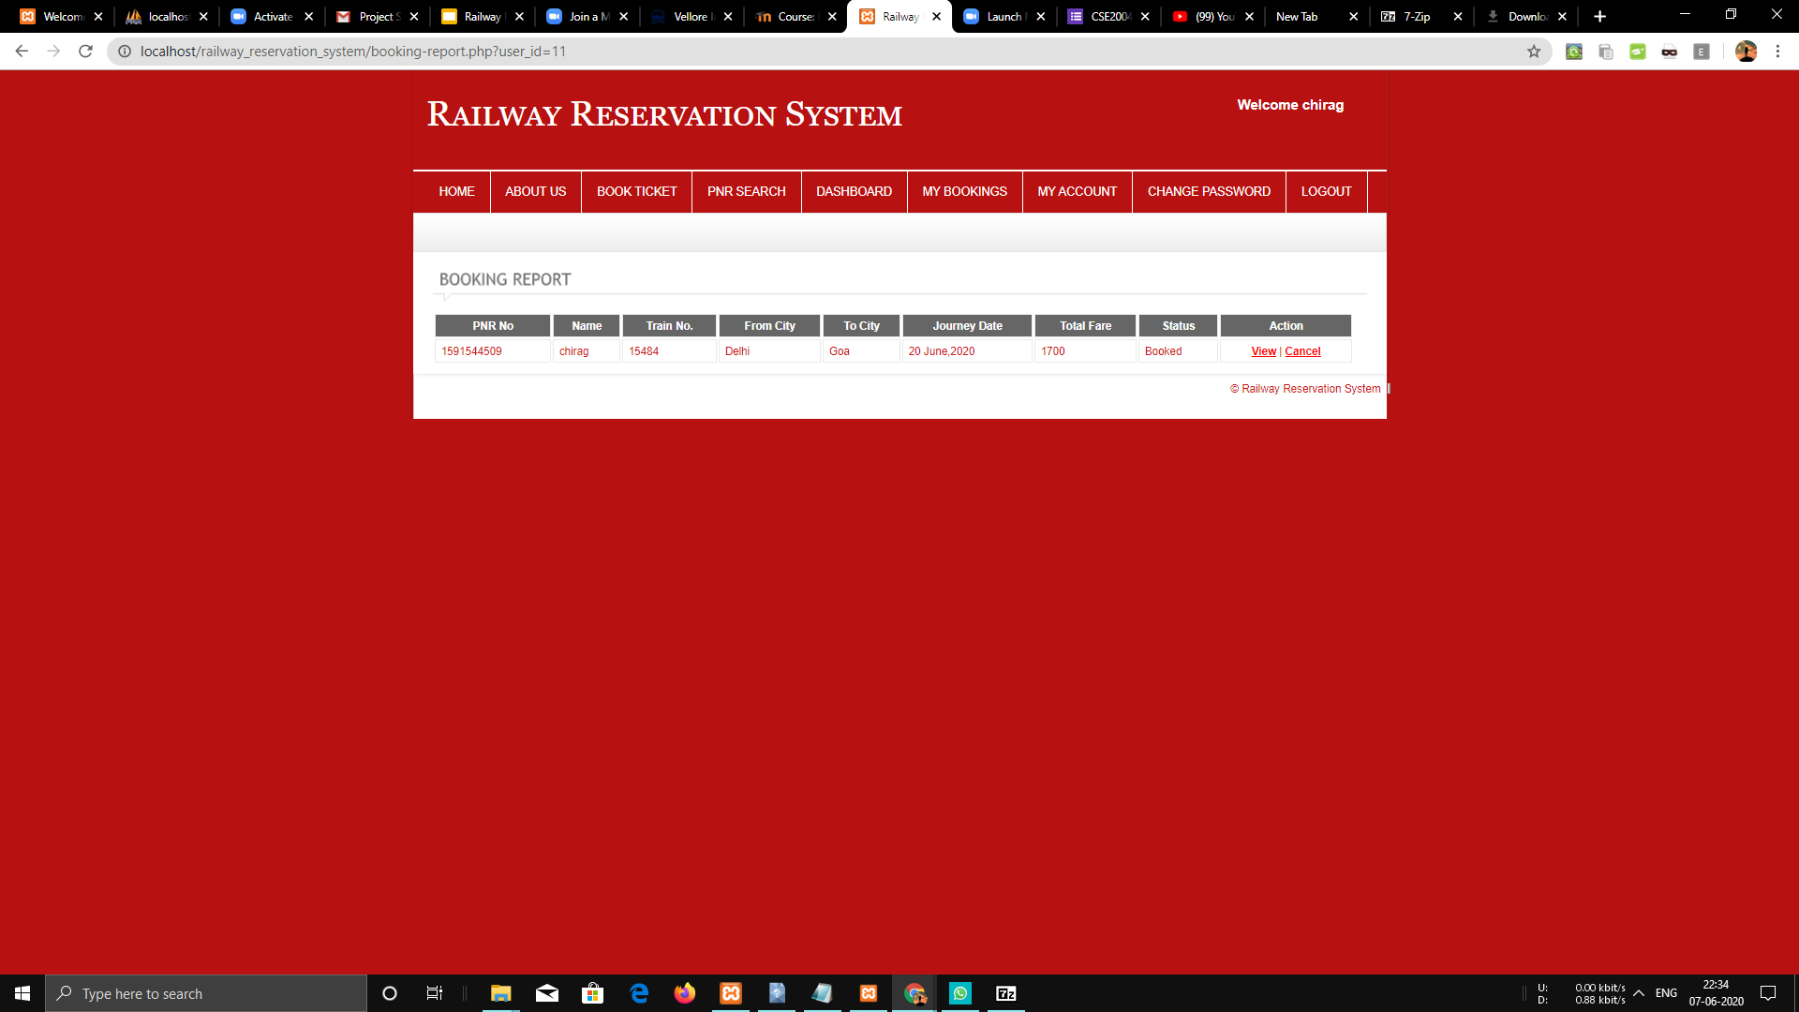

Slide 26
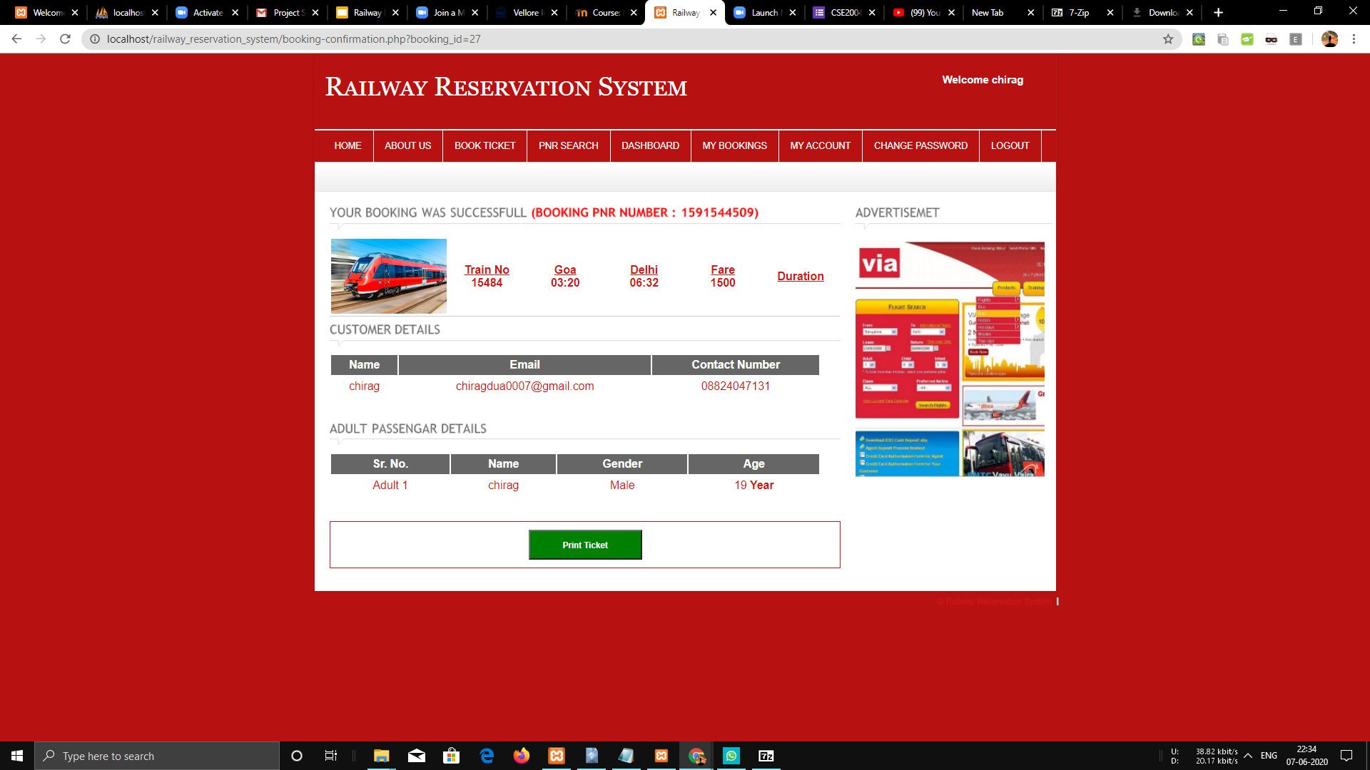

Slide 27
